Slide 1
Intelligent ambulance using IOT

Slide 2
Outline
1) Introduction​
​2) Literature Survey
3) Problem Statement
4) Objectives
5) Block Diagram
6) Methodology
7) Architecture design flow
8) Modern tools
9) Hardware and Software requirements
10) Output(Till Date)
11) Publication Status of phase 1
12) Time scheduling
13) Conclusions
14) References

Slide 3
Introduction
Traffic management on the road has become a biggest severe problem of today's society.
Amidst all these frenzied life, one forgets the importance of human life .This is a very serious problem even in case of road accident one even doesn’t care to call the emergency unit.
To overcome this hazard and to save many lives, we are going to develop a model which provides the functionality of one path clearance i.e. the ambulance going path will be cleared. This scenario is done by upgrading technology called Internet of Things.
In traffic load everyone has to wait until they get green signal especially when ambulance has arrived it must wait to clear the vehicles on road ,this principal is based on vehicle detection, image processing vehicle detector method.

Slide 4
LITERATURE SURVEY
Sl. No. | Title and Author | Journal and Year | Observations | Take Away Points
1) | Advanced Ambulance Emergency Services Using GPS Navigation Ramasami S, Gowri Shankar E, Moulishankar R, Sriramprasad D, Sudharsan Narayanan P | ETEDM – 2018 (Volume 6 – Issue 04) | Observed the usage of GPS for the ambulance . | The usage of GPS enables the driver to find the shortest distance to the nearby hostpital.
2) | An Efficient IoT Enabled Smart Ambulance Nila Sultana, Methila Farzana Woishe, Tamanna Zaman Bristy , Dr.Md. Taimur Ahad | Turkish Journal of Computer and Mathematics Education Vol.13 No.02 (2022), 157-170 157 | Observed methods for determining traffic density on roads using image processing techniques and a model for controlling traffic signals based on information received from images of roads taken by a video camera. | We have taken the concept of using image processing to determine the density of vehicles and control the traffic signals.

Slide 5
Sl. No. | Title and Author | Journal and Year | Observations | Take Away Points
3) | GPS BASED TRAFFIC SIGNAL CONTROL SYSTEM FOR AMBULANCE USING MACHINE LEARNING M. Abirami, G. Archana, R. S. Dheepika,M. Keerthana | International Research Journal of Engineering and Technology(IRJET) Volume: 08 Issue: 04 | Apr 2021 | The main aim of the paper is to design a Microcontroller based intelligent ambulance system which can change the traffic lights upon its arrival at traffic light junction using IR(Infrared) sensors. | Resets the time to green signal whenever ambulance has in path which got the traffic load and making the opposite signal board to red signal
4) | IoT based heart monitoring and alerting system with cloud computing and managing the traffic for an ambulance in India. Bhagchandani, K., & Augustine, D. P. | International Journal of Electrical and Computer Engineering, 9(6), 5068. Year -2019. | Uses cloud computing technology to monitor heart beat of the patient. | Both traffic controlling and health monitoring systems will work concurrently.
5) | A Vehicle Detection Technique for Traffic Management using Image Processing | International Conference on Computer, Chemical, Material and Electronic Engineering(IC4ME2) | The model proposed in this paper is an attempt to detect the number of vehicles on road in real time. | The accuracy of the detection can be increased by using image processing rather than traditional detection methedology.

Slide 6
Problem Statement
One of the most challenging problems of urban civilization is directly or indirectly related to population explosion:
1)Traffic congestion hampers the speed of vehicles which also include emergency vehicles like ambulances.
2) Unnecessary waiting at the traffic signals due to unequal traffic density.
3)Absence of knowledge about the routes of a city.

Slide 7
Objectives
GPS Ambulance Tracking System solution focus to make the ambulance available to a patient in the shortest possible time.
Traffic flow control aims to adjust and control flour of traffic in order to fulfill the needs of vehicle flow and to reduce the waiting time. This can be implemented using digital image processing based on traffic density regulation.
Intelligent ambulance also have some extra features such as while in the way to hospital before providing the first aid to the patient one can detect the patient health status. This can be communitated through nodemcu to the respective hospital.

Slide 8
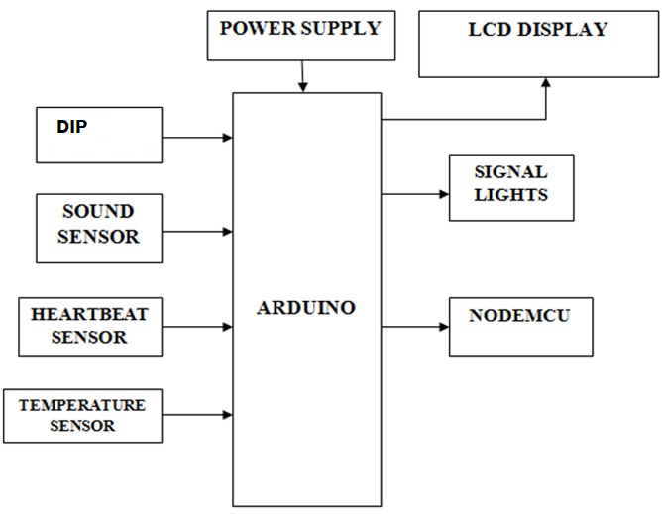
Block Diagram

Slide 9
Methodology
In this proposed methodology, We will provide solution to congestion, traffic clearance to ambulance .And one of the plus point of the system is we have designed the system in automatic mode.
The Microcontroller is the main part of the system to which LCD Display, Digital image processing, sound sensor , heartbeat and temperature sensor ,signal lights and node-mcu are connected.
When an Ambulance approaches the signal junction, the transmitter in the Ambulance sends signal to the receiver which is placed at the traffic signal junction. Whether is Low traffic density, or Medium traffic density, or High traffic density.

Slide 10
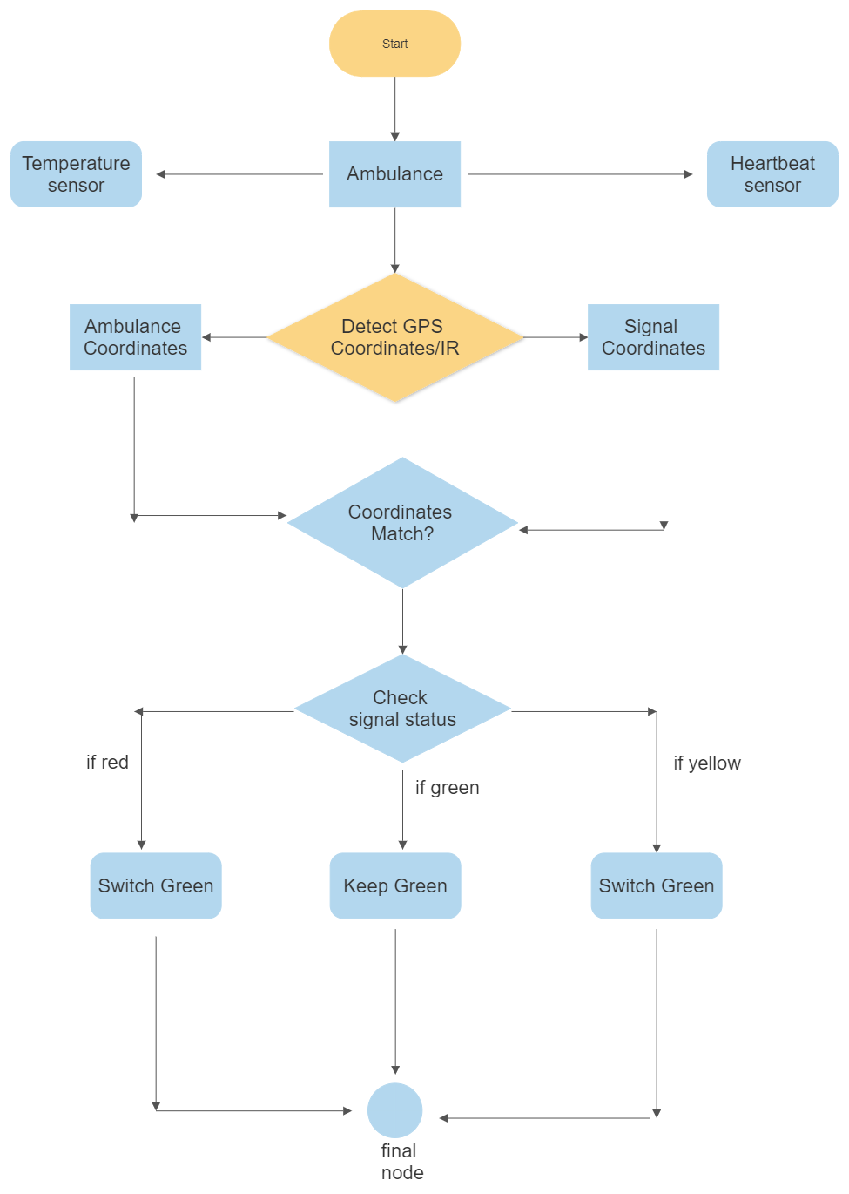
Architecture design flow

Slide 11
Modern Tools
Digital Image Processing : Digital Image Processing is the use of computer algorithms to process digital images for various applications. In the Intelligent Ambulance project, Digital Image Processing is used to find the shortest route for the ambulance by analyzing real-time traffic conditions. It is also used to calculate vehicle density by analyzing live video feeds from cameras on the road. Additionally, it is used to control traffic lights by detecting the presence of an ambulance and changing the signal to green to clear the way for the emergency vehicle.
Node MCU : Node MCU is an open-source firmware and development board based on the ESP8266 Wi-Fi chip. It allows for easy connection to the internet and communication with other devices. In the Intelligent Ambulance project, Node MCU is used to send vital information about the patient, such as heartbeat rate and body temperature, to the nearest hospitals via telegram. It achieves this by connecting to the internet through Wi-Fi and using a telegram API to send the message to the hospital.
Arduino UNO Microcontroller : Arduino Uno is a microcontroller board based on the ATmega328P chip that can be programmed to perform various tasks. It has a variety of input and output pins that can be used to interface with sensors and actuators. In the Intelligent Ambulance project, the Arduino Uno is used to process data from various sensors, such as the LM35 temperature sensor and heartbeat rate sensor, and send the data to the Node MCU for transmission to the hospital. It is also used in the traffic control system to process data from the IR and sound sensors and control the traffic lights accordingly

Slide 12
Hardware and software requirements
Hardware:
Software:
Arduino Uno
Sound Sensor
Temperature Sensor
Heartbeat Sensor
IR Sensors
Signal Lights
Nodemcu
Power Supply
Arduino IDE
Embedded C

Slide 13
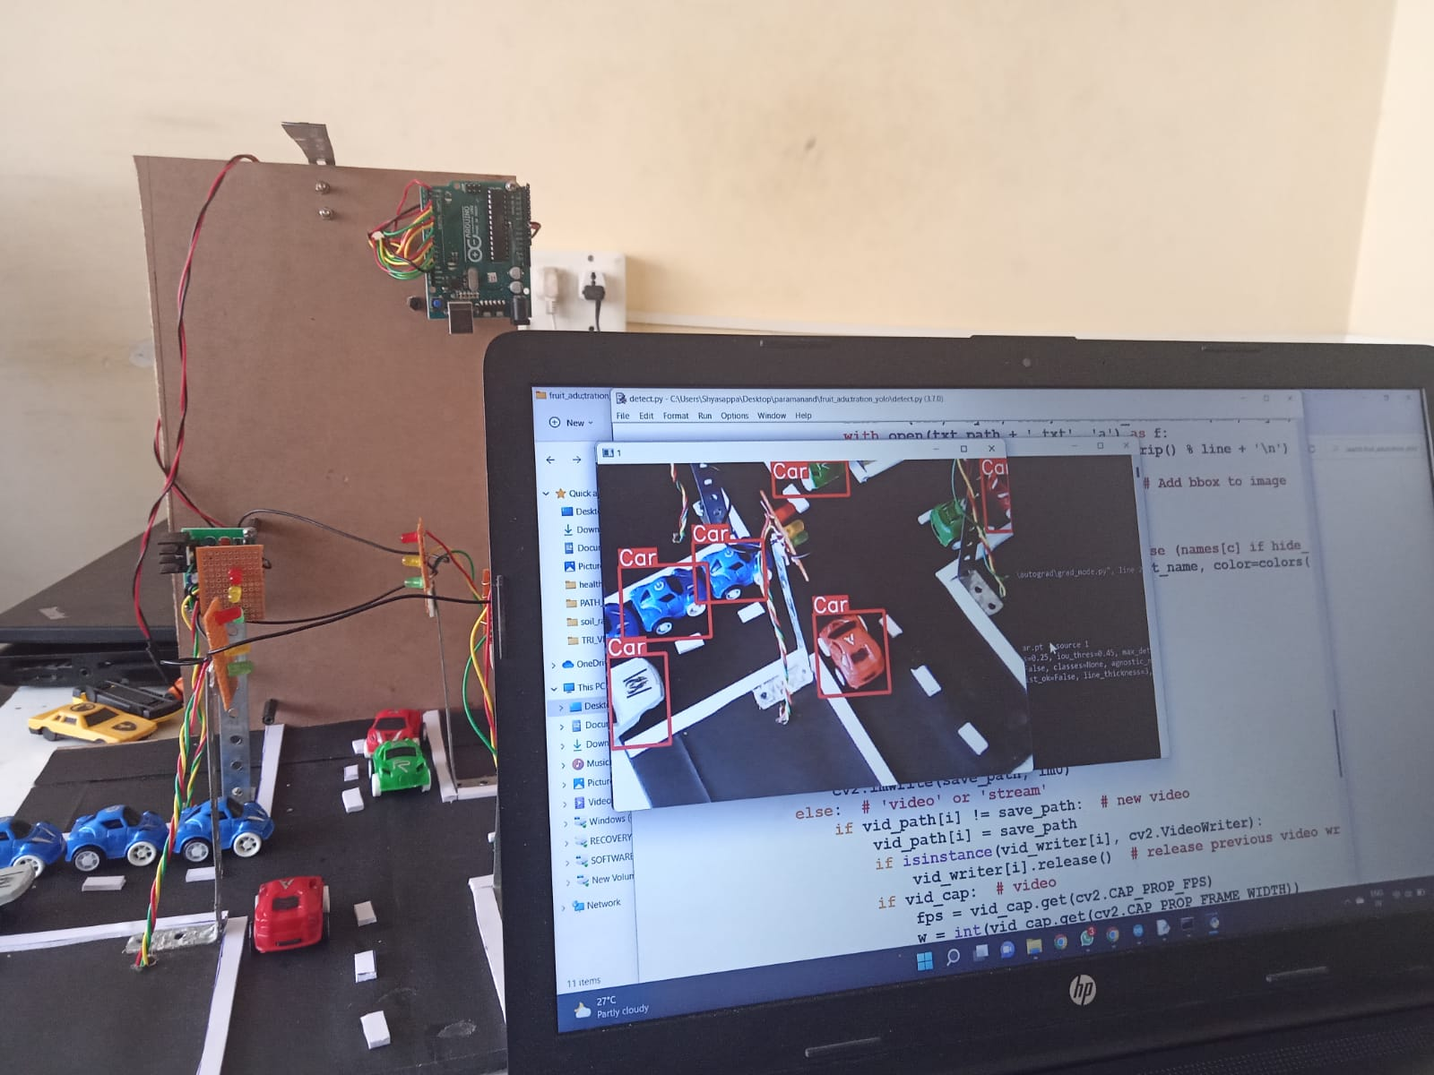
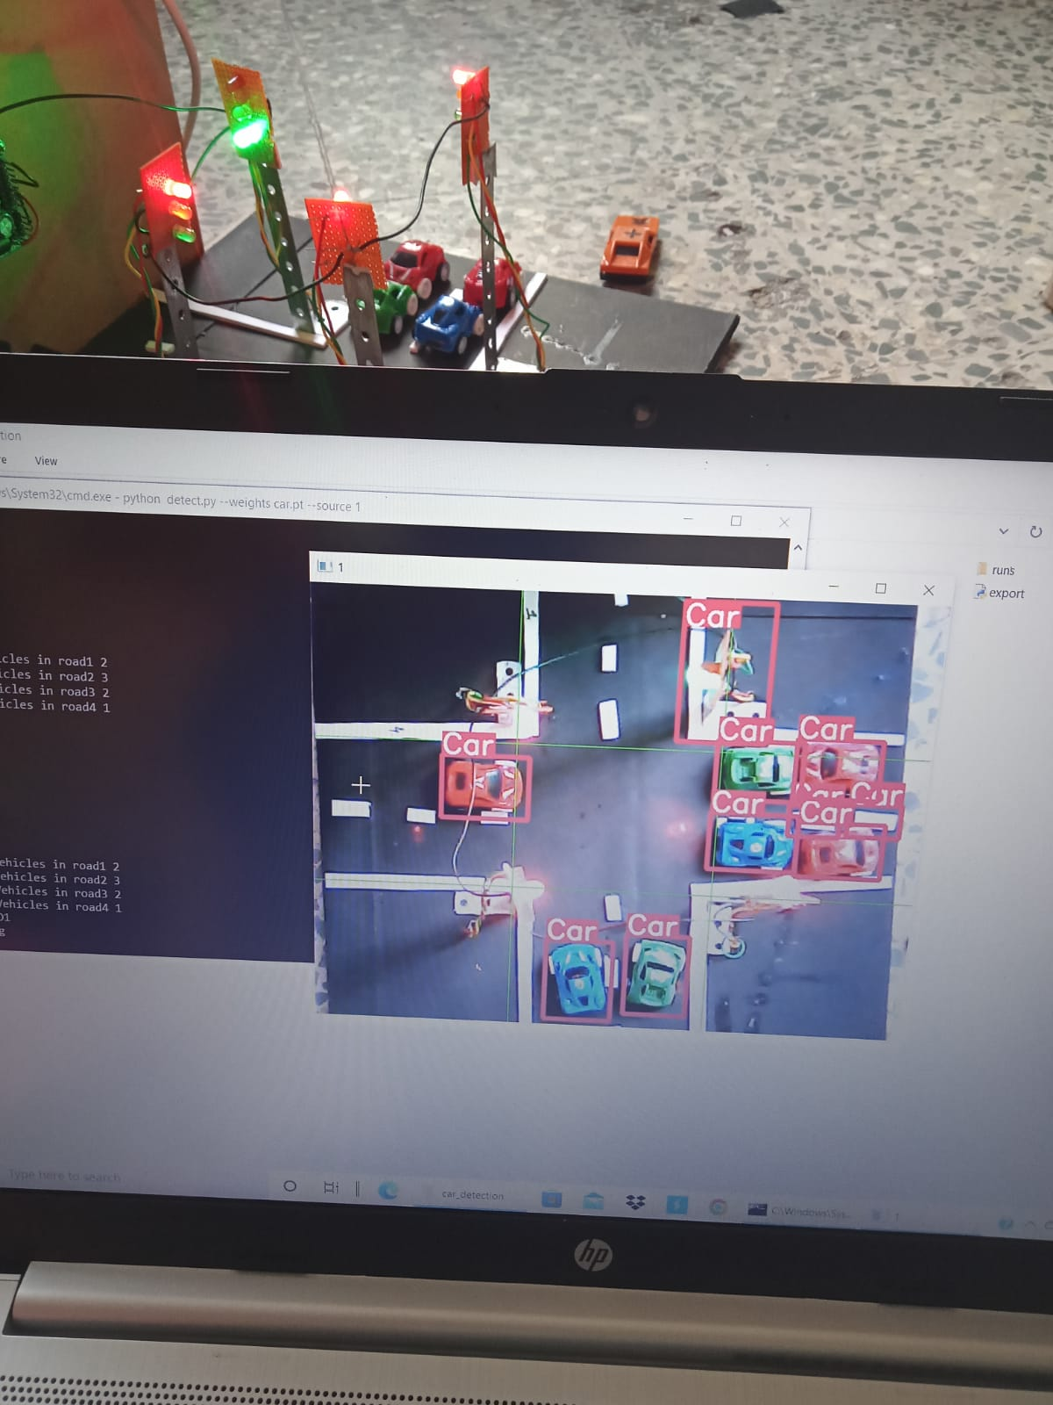
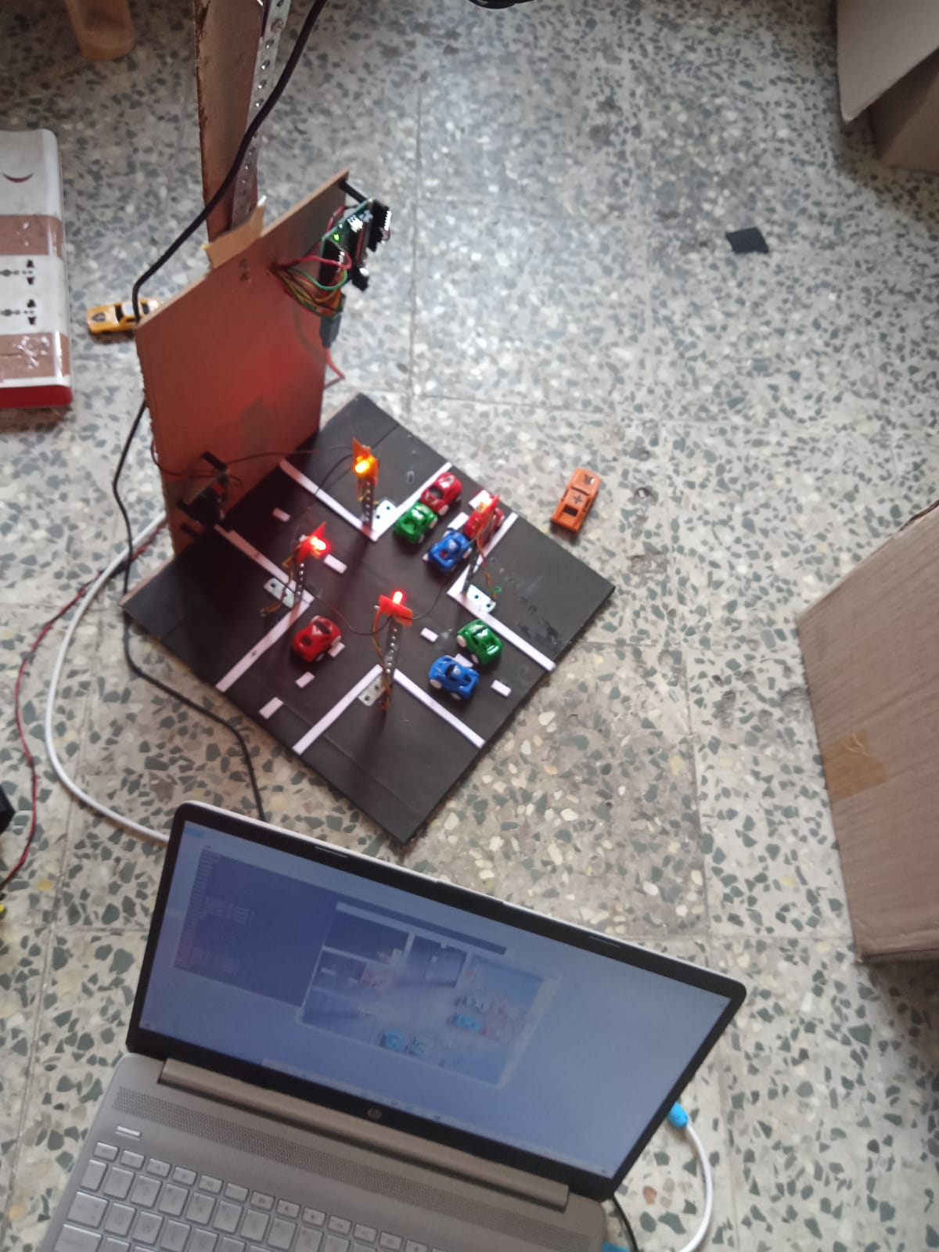
Output (Till date)

Slide 14
Publication status of phase 1
We are pleased to announce that our paper on "Intelligent Ambulance Using IoT" has been published in the Journal of Electronics and Communication Systems (MAT Journals), Volume 8, Issue 1 in the year 2023.
→ The paper describes a system that uses IoT devices and image processing techniques ……to provide a .faster and more efficient way of transporting patients to the hospital. ……The system also includes a.patient monitoring system that sends vital information ……to the nearest hospital. The proposed system has the potential to save lives in ……urban areas where traffic congestion is a major issue. The publication of this paper ……is a significant milestone in our efforts to develop technology solutions that can ……help address critical healthcare challenges.

Slide 15
Time scheduling

Slide 16
Conclusion
The existing traffic management system in India has fixed timers for traffic signals to switch traffic between different direction and no specific changes in traffic signals for emergency vehicles.
And real time tracking helps the person who called the ambulance to track the movements of ambulance and call another ambulance if the called ambulance is taking too long to reach.
This project can be life saver

Slide 17
References
Shantanu Sarkar, Ambulance Assistance for Emergency Services Using GPS Navigation in International Research Journal of Engineering and Technology (IRJET), September,2016
G.Araprasad, “High stable power aware multicast algorithm for mobile ad hoc networks,” “IEEE Sensors J.”, Volume: 05 Issue: 09 | Sep 2018, page no:423-426.
Saha, H. N., Raun, N. F., & Saha, M. (2017, August). Monitoring patient's health with smart ambulance system using Internet of Things (IOTs). In 2017 8th Annual Industrial Automation and Electromechanical Engineering Conference (IEMECON) (pp. 91-95). IEEE.
Saurabh Kapoor, Parul Gupta, Pooja Sharma, Prabhu Nath Singh Intelligent Ambulance with Automatic Traffic Control ,International Research Journal of Engineering and Technology (IRJET) Volume:04 Issue:04 ,2017,page no-1264-1266
Rajeshwari S., Santhoshs Hebbar, Varaprasad Golla: “Implementing Intelligent Traffic Control System for Congestion Control, Ambulance Clearance and Stolen Vehicle Detection”, IEEE Sensors Journal, 2013, Vol 10, pp. 1530-437X(c).

